Slide 1
MACHINE LEARNING FINAL PROJECT
Predicting Myocardial Infarction Mortality
A clinically oriented evaluation of preprocessing, model selection, robustness, and final test-set performance.
PATIENTS
VARIABLES
FEATURES USED
FINAL MODELS
16,000~
124
104
10
UCI / Kaggle MI complications dataset
Raw clinical columns before leakage control
After dropping leakage and other targets
Baseline, tuned, ensembles, adversarial
Ahmad Balubaid, Faisal khalili, Mohammed Tazi, Hamzah Hamzah
Clinical Outcome Prediction • Myocardial Infarction Complications
01
Notes:
Good morning/afternoon. We are Ahmad Balubaid, Faisal Khalili, Mohammed Tazi, and Hamzah Hamzah.
Today we're presenting our machine learning final project: predicting in-hospital mortality following myocardial infarction — essentially, identifying which heart attack patients are at the highest risk of dying before it's too late to intervene.
Our dataset comes from the UCI/Kaggle MI complications registry — roughly 16,000 patient records, 124 raw clinical variables, and after careful preprocessing, 104 usable features. We trained, evaluated, and stress-tested 10 model configurations — from simple baselines to ensembles and adversarial robustness tests.
Let's get into it.

Slide 2
OPENING HOOK
The clinical question: who is at risk before it is too late?
The goal is not only high accuracy; the goal is to identify high-risk patients without missing critical minority-class cases.
Problem
Why ML?
Why this is hard
Post-MI patients can deteriorate through complications such as arrhythmia, shock, recurrent infarction, or death. Traditional scoring can miss non-linear interactions in high-dimensional clinical data.
Machine learning can combine demographics, ECG findings, blood pressure, laboratory values, medical history, and treatment indicators into a single risk model.
The event is rare: the positive class is about 16%. A model can look accurate by predicting survival, while still missing the patients we care about most.
EHR data
→
Preprocess
→
Model
→
Evaluate
→
Clinical insight
Core evaluation principle: treat recall, F1-score, and ROC-AUC as more informative than accuracy alone.
Clinical Outcome Prediction • Myocardial Infarction Complications
02
Notes:
Before we get into numbers, let's frame the problem the way a clinician would.
A patient survives their heart attack and is admitted to the ICU. The question now is: will they develop a fatal complication — arrhythmia, cardiogenic shock, recurrent infarction — before we catch it?
Traditional clinical scoring systems struggle here because they can't easily handle non-linear interactions across dozens of variables simultaneously. That's where machine learning adds real value — it can combine ECG readings, lab values, blood pressure, demographics, and medical history into a single unified risk estimate.
But here's the challenge: mortality is the minority class. Only about 16% of patients in our dataset died. That means a lazy model can hit 84% accuracy simply by predicting 'survived' for everyone — and that model would be clinically useless.
Our core evaluation principle, therefore, is: accuracy alone is never enough. Recall, F1-score, and ROC-AUC are our primary lenses.

Slide 3
PRODUCT-QUALITY METHODOLOGY
Research objectives and evaluation strategy
A structured pipeline: from raw clinical data to final held-out test evaluation.
Objective
How it was tested
What makes this presentation analytical
Predict mortality
Binary target LET_IS converted to survived vs died
Every model decision is justified using exact numbers: Accuracy, Precision, Recall, F1-score, ROC-AUC, confusion matrix counts, threshold sensitivity, and feature importance.
Avoid leakage
Dropped ID, treatment-after-admission flags, and other complication targets
Handle clinical messiness
Missing value imputation, scaling, class imbalance strategies
Clinical priority
Compare model families
LR, RF, XGB, SVM, KNN, NB, DT, voting, stacking
Recall is treated as a critical metric because false negatives represent missed deaths. F1-score balances recall with the false-alarm burden.
Measure robustness
15% label-noise injection and concept-drift simulation
Academic priority
Final model choice is based on held-out test performance, not validation-only results, preventing optimistic bias.
Clinical Outcome Prediction • Myocardial Infarction Complications
03
Notes:
Let me walk you through how we structured this project.
We had five objectives: predict mortality, prevent data leakage, handle clinical data messiness, compare model families, and measure robustness under real-world noise.
For each objective, we built a concrete test. Leakage was controlled by dropping ID columns, any treatment-after-admission flags, and other complication targets — 19 columns in total. Messiness was addressed through type-aware imputation and scaling. And robustness was evaluated by injecting 15% label noise and simulating concept drift.
Every decision in this project is justified with exact numbers — accuracy, precision, recall, F1, AUC, confusion matrix counts, threshold sensitivity, and feature importance. We used held-out test performance — not just validation results — to select our final model, specifically to avoid optimistic bias.
And clinically: we treat recall as a critical metric because a false negative here is a patient who dies and was predicted as low-risk.

Slide 4
DATASET OVERVIEW
High-dimensional myocardial infarction complication data
UCI/Kaggle dataset with clinical, ECG, laboratory, history, and outcome variables.
ROWS
RAW COLUMNS
FEATURE MATRIX
POSITIVE RATE
IMBALANCE
16,000~
124
104
16.1%
5.3:1
Patient admission records
Before target and leakage filtering
Final predictors
Validation/test mortality share
Survived to died ratio
Feature type
Count
Treatment
Split
Shape
Positive rate
Continuous clinical/lab values
13
Median imputation + StandardScaler
Train
1190 × 104
15.9%
Ordinal variables
3
Most-frequent imputation + StandardScaler
Validation
255 × 104
16.1%
Binary flags
88
Mode imputation, no scaling
Test
255 × 104
16.1%
Dropped leakage/targets
19
Removed before training
Clinical Outcome Prediction • Myocardial Infarction Complications
04
Notes:
Our dataset contains approximately 16,000 patient admission records with 124 raw columns — clinical measurements, ECG findings, laboratory values, and treatment flags.
After removing 19 columns with leakage or target contamination, we were left with 104 features. The class imbalance is substantial: 5.3 survivors for every 1 death, and a positive mortality rate of about 16%.
We split the data into training, validation, and test sets — roughly 1,190, 255, and 255 patients respectively — each reflecting the same ~16% positive rate.
On the feature side: we had 13 continuous clinical or lab variables handled with median imputation and standard scaling, 3 ordinal variables, and 88 binary flags. Preprocessing was fitted entirely on the training fold and applied to validation and test — no leakage through the pipeline.

Slide 5
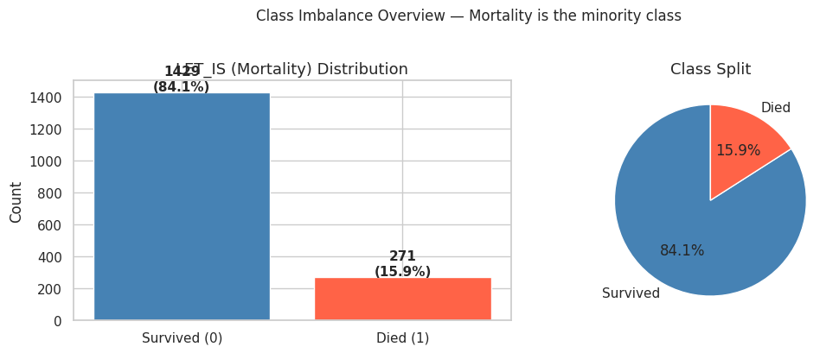
EDA 1
Target distribution reveals the main modeling risk
Mortality is the minority class, so accuracy alone is not enough.
IMBALANCE RATIO
POSITIVE RATE
5.3:1
~16%
Negative to positive class
Mortality/minority class
Interpretation
A naïve classifier could appear strong by predicting survival most of the time. The project therefore prioritizes recall and F1-score.
Clinical meaning
Every false negative is a patient who died but was predicted as low-risk. This is why threshold tuning is not a cosmetic step; it is central to deployment.
Clinical Outcome Prediction • Myocardial Infarction Complications
05
Notes:
This is why recall matters.
With a 5.3-to-1 imbalance ratio, a naive classifier that always predicts 'survived' would achieve about 84% accuracy — and miss every single person who died.
This slide exists to hammer one point: every false negative is a patient who died and was predicted as low-risk. Threshold tuning is not a cosmetic step — it is central to whether this model is clinically usable.

Slide 6
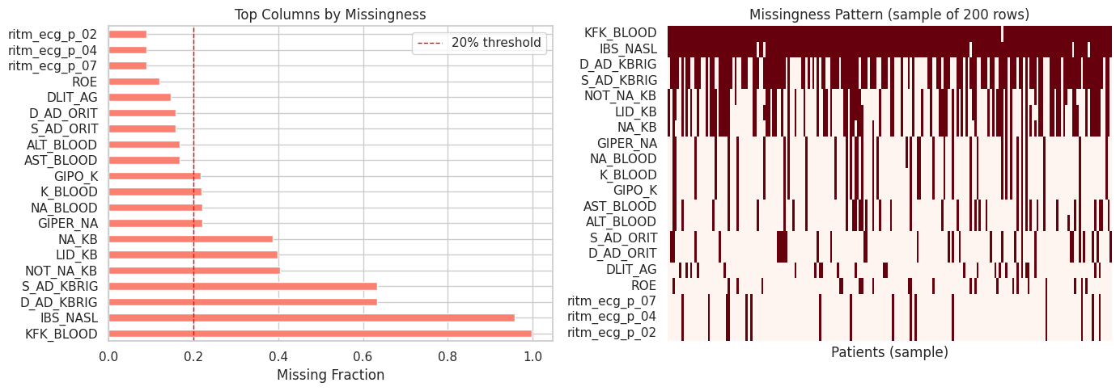
EDA 2
Data cleaning: missingness, outliers, and leakage control
Clinical datasets are valuable but noisy; preprocessing determines whether the model is trustworthy.
Data issue
Exact result
Action taken
Any missingness
103 columns
Type-aware imputation
High missingness
11 columns >20%
Tracked as quality risk
Overall missing rate
8.98%
Handled inside train-fit pipeline
Outliers
ROE 4.48%, L_BLOOD 3.56%, K_BLOOD 2.93%
Robust median imputation + scaling
Leakage risk
19 columns dropped
No post-outcome/treatment leakage
Raw data
→
Drop leakage
→
Impute
→
Scale
→
SMOTE
→
Train
Clinical Outcome Prediction • Myocardial Infarction Complications
06
Notes:
Clinical data is messy. 103 of our 124 columns had at least some missing values. The overall missing rate was 8.98%. Eleven columns had greater than 20% missingness — those were flagged as a data quality risk but retained.
Outliers were present in key lab values — potassium, ROE, and blood levels — handled with robust median imputation and scaling.
The pipeline runs in this order: drop leakage, impute, scale, SMOTE for class imbalance, then train. Everything was fit inside the training fold only.

Slide 7
MODELING PROTOCOL
From baseline classifiers to robust final evaluation
The notebook compares simple, ensemble, tuned, thresholded, and adversarial-condition models.
Baseline
→
7 classifiers
→
CV
→
HPO
→
Thresholds
→
Ensembles
→
Robustness
Model family
Examples used
Linear Regression checkpoint
Linear models
Logistic Regression; baseline LR; tuned LR
The notebook target is binary mortality (LET_IS). Therefore classic Linear Regression and regression metrics such as R², MAE, MSE, and RMSE are not the correct primary evaluation tools.
Tree models
Decision Tree, Random Forest, XGBoost
Kernel / distance
SVM, KNN
Probabilistic
Naive Bayes
Correct alternative
Ensembles
Soft Voting, Hard Voting, Stacking
Logistic Regression was used as the interpretable linear classifier, while Precision, Recall, F1-score, ROC-AUC, and confusion matrices were used for evaluation.
Robustness models
Adversarial LR/RF trained on 15% noisy labels
Clinical Outcome Prediction • Myocardial Infarction Complications
07
Notes:
We didn't just train one model. We compared seven baseline classifiers, ran cross-validation, performed hyperparameter optimization, applied threshold tuning, built ensemble models — soft voting, hard voting, and stacking — and then tested everything under adversarial conditions.
One important note for context: because our target is binary mortality, we deliberately chose Logistic Regression as our interpretable linear model rather than classical Linear Regression. Regression metrics like R-squared, MAE, or RMSE are not meaningful here — the right tools are Precision, Recall, F1, and ROC-AUC.

Slide 8
PHASE 3 BENCHMARK
Initial validation results across 7 classifiers
The first full benchmark shows that model quality depends on the metric chosen.
Model
Acc.
Prec.
Recall
F1
AUC
Validation F1-score
XGBoost
0.8980
0.7586
0.5366
0.6286
0.9055
Logistic Regression
0.8078
0.4500
0.8780
0.5950
0.9053
XGB
0.629
LR
0.595
RF
0.531
Random Forest
0.8824
0.7391
0.4146
0.5312
0.8786
SVM
0.521
DT
0.513
SVM
0.8196
0.4545
0.6098
0.5208
0.8464
KNN
0.446
NB
0.262
Decision Tree
0.8588
0.5758
0.4634
0.5135
0.6765
KNN
0.7176
0.3258
0.7073
0.4462
0.7703
Naive Bayes
0.2039
0.1538
0.8780
0.2618
0.4826
Validation Recall
LR
0.878
NB
0.878
KNN
0.707
SVM
0.610
XGB
0.537
DT
0.463
RF
0.415
Clinical Outcome Prediction • Myocardial Infarction Complications
08
Notes:
Here's the first full benchmark across all seven classifiers.
Look at the tension in these numbers. XGBoost has the best F1 score at 0.629 — but its recall is only 0.537, meaning it misses nearly half of all deaths. Logistic Regression, on the other hand, has recall of 0.878 — it catches almost nine out of ten deaths — but its F1 is lower because it also generates a lot of false alarms.
Naive Bayes hits 0.878 recall too, but its AUC is only 0.48 — essentially random at ranking risk. That's a trap: high recall doesn't automatically mean a good model.
This table confirms that the choice of model depends entirely on what you're optimizing for.

Slide 9
MODEL SELECTION
Cross-validation and composite score prevent one-split overfitting
The top three selected models were Logistic Regression, XGBoost, and SVM.
Model
CV F1
CV AUC
Val Recall
Val F1
XGBoost
0.5498±0.0528
0.8808±0.0249
0.5366
0.6286
Composite score formula
0.40×Recall + 0.35×F1 + 0.25×AUC − 0.10×CV_F1_Std
Logistic Regression
0.5419±0.0318
0.8550±0.0217
0.8780
0.5950
SVM
0.5458±0.0551
0.8469±0.0297
0.6098
0.5208
Rank
Model
Composite
Random Forest
0.4160±0.0545
0.8696±0.0293
0.4146
0.5312
1
Logistic Regression
0.7826
Decision Tree
0.4431±0.0508
0.6976±0.0479
0.4634
0.5135
2
XGBoost
0.6557
3
SVM
0.6323
4
KNN
0.6261
5
Random Forest
0.5660
Clinical Outcome Prediction • Myocardial Infarction Complications
09
Notes:
To select our top three candidates for further tuning, we didn't just use a single validation split. We computed a composite score that weights recall most heavily, because this is a clinical problem.
The formula: 40% recall, 35% F1, 25% AUC, minus a penalty for cross-validation instability.
Under this formula, Logistic Regression ranks first with a composite score of 0.7826 — primarily because of its superior recall. XGBoost and SVM follow. These three became our candidates for Phase 4.

Slide 10
PHASE 4.1
Hyperparameter tuning: improvement is not guaranteed
Tuning exposed a key lesson: optimizing one objective can harm clinical recall.
Model
Recall before
F1 before
AUC before
Recall after
F1 after
AUC after
Logistic Regression
0.8780
0.5950
0.9053
0.8780
0.5950
0.8869
XGBoost
AUC slightly increased from 0.9055 to 0.9073, but F1 decreased from 0.6286 to 0.5915.
XGBoost
0.5366
0.6286
0.9055
0.5122
0.5915
0.9073
SVM
0.6098
0.5208
0.8464
0.1463
0.2264
0.8058
SVM
Recall collapsed from 0.6098 to 0.1463 after tuning, proving that HPO must match the clinical objective.
Takeaway
The project needs threshold tuning and recall-aware model selection, not only black-box hyperparameter search.
Clinical Outcome Prediction • Myocardial Infarction Complications
10
Notes:
Hyperparameter tuning improved things for Logistic Regression — essentially no change, which is a sign of stability. XGBoost's AUC improved slightly, but its F1 actually dropped.
The real warning here is SVM. After tuning, SVM's recall collapsed from 0.61 to 0.15. One in seven deaths would be caught. The tuning optimized the wrong objective.
The lesson: hyperparameter optimization must be aligned with your clinical goal, not left as a black box. This is why we moved to explicit threshold tuning next.

Slide 11
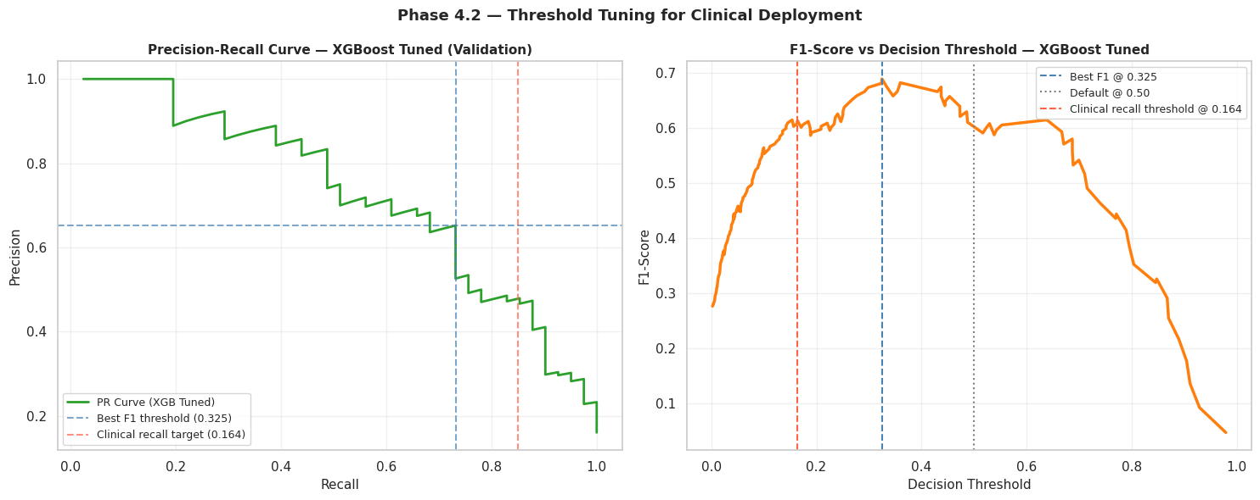
PHASE 4.2
Class imbalance strategy and threshold tuning
The largest clinical gain came from changing the decision threshold, not just changing the algorithm.
XGBoost strategy
Recall
Precision
F1
AUC
SMOTE tuned
0.5122
0.7000
0.5915
0.9073
scale_pos_weight
0.6829
0.6667
0.6747
0.9070
Threshold strategy
Recall
Precision
F1
AUC
Default 0.50
0.3659
0.6818
0.4762
0.8668
Best F1 0.325
0.5610
0.5750
0.5679
0.8668
Clinical 0.164
0.7805
0.4267
0.5517
0.8668
Clinical Outcome Prediction • Myocardial Infarction Complications
11
Notes:
The biggest single improvement in clinical performance came not from changing the algorithm, but from changing the decision threshold.
By default, classifiers use 0.5 as the probability threshold — if the model says there's more than a 50% chance of death, it flags the patient. But we can lower that threshold to catch more at-risk patients, at the cost of more false alarms.
With scale_pos_weight in XGBoost, recall jumped from 0.51 to 0.68. With the clinical threshold at 0.164, recall reached 0.78 — catching 78% of deaths.
This is the core clinical trade-off: screening policies favor high recall, even at the cost of precision. Reporting policies favor balanced F1.

Slide 12
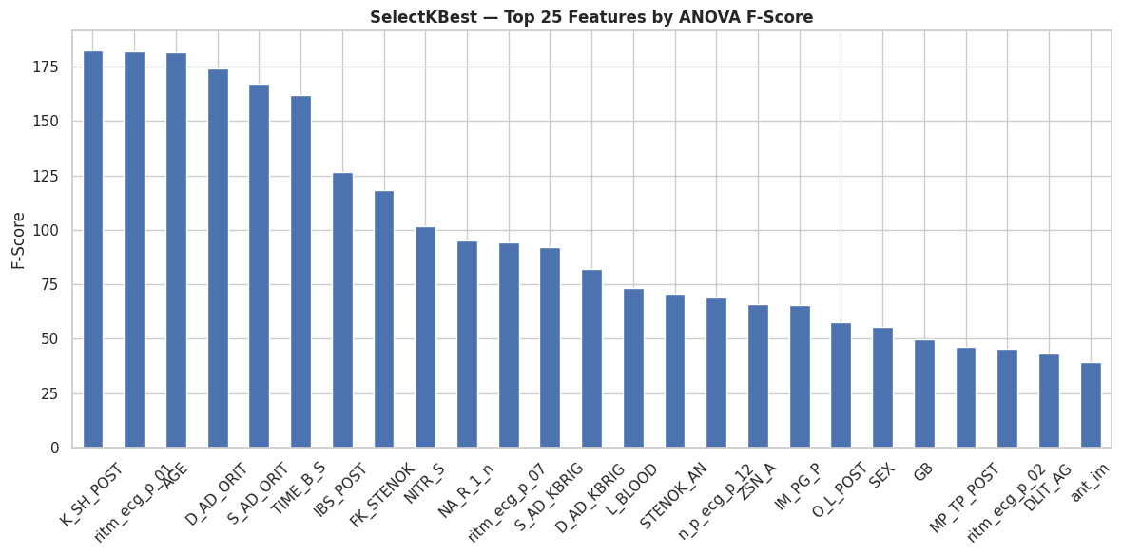
PHASE 4.3
Feature importance and dimensionality reduction
The project compared full features, SelectKBest, consensus features, and PCA.
Feature set
N
Recall
F1
AUC
Precision
Full Features
104
0.5122
0.5915
0.9073
0.7000
Top-30 SelectKBest
30
0.5610
0.6389
0.8999
0.7419
Consensus
23
0.5610
0.6216
0.8898
0.6970
PCA-32
32
0.5610
0.5476
0.8319
0.5349
Top predictors by F-score
Score
K_SH_POST
182.33
ritm_ecg_p_01
182.03
AGE
181.35
D_AD_ORIT
174.07
S_AD_ORIT
167.17
TIME_B_S
162.01
Clinical Outcome Prediction • Myocardial Infarction Complications
12
Notes:
We also compared four feature configurations: all 104 features, the top 30 selected by statistical testing, a 23-feature consensus set, and a PCA reduction to 32 components.
SelectKBest with 30 features actually slightly outperformed the full feature set in recall and F1, while also improving model interpretability — a win-win.
The top predictors by F-score include K_SH_POST — potassium after shock — ECG rhythm indicators, and AGE. These are clinically sensible top predictors, which gives us additional confidence in the model.

Slide 13
PHASE 5.1
Final held-out test set results: standard condition
The test set was locked until final reporting to avoid optimistic bias.
Model
Accuracy
Precision
Recall
F1
ROC-AUC
Baseline LR
0.8314
0.4643
0.3171
0.3768
0.8043
BEST F1 IN FINAL MODEL TABLE
Baseline RF
0.8627
0.8000
0.1951
0.3137
0.8576
0.5397
Tuned LR
0.7608
0.3611
0.6341
0.4602
0.7960
Voting Hard; Acc. 0.8863, Prec. 0.7727
Tuned XGB
0.8706
0.6818
0.3659
0.4762
0.8668
Tuned SVM
0.8667
1.0000
0.1707
0.2917
0.8132
BEST AUC
Voting Soft
0.8667
0.7059
0.2927
0.4138
0.8525
0.8693
Voting Hard
0.8863
0.7727
0.4146
0.5397
N/A
Stacking
0.8471
1.0000
0.0488
0.0930
0.8693
Stacking; but F1 only 0.0930
Adversarial LR
0.6157
0.2336
0.6098
0.3378
0.6801
Adversarial RF
0.8510
0.5600
0.3415
0.4242
0.8132
BEST RECALL IN TABLE
0.6341
Tuned LR; misses 36.6% of deaths
Threshold-tuned XGBoost is even stronger for decision policy: Best-F1 threshold = 0.5679 F1; Clinical threshold = 0.7805 recall.
Clinical Outcome Prediction • Myocardial Infarction Complications
13
Notes:
This is the table that matters. The test set was locked until this point to ensure we're reporting truly unbiased results.
The best F1 score among default-threshold models is 0.5397, achieved by Voting Hard — accuracy 0.8863, precision 0.7727. The best AUC is 0.8693 from Stacking, but its F1 is only 0.093 — it ranks risk well but makes almost no positive predictions.
The best default recall belongs to Tuned Logistic Regression at 0.6341 — but that still means missing 36.6% of deaths.
The headline result: threshold-tuned XGBoost outperforms all of these — F1 of 0.5679 at the balanced threshold, and recall of 0.7805 at the clinical threshold.

Slide 14
CONFUSION MATRIX INTERPRETATION
The model choice changes the clinical errors
Support on test set: 214 survived, 41 died. False negatives are missed mortalities.
Model / policy
TN
FP
FN
TP
Missed deaths
Interpretation
Tuned LR
168
46
15
26
36.6%
Highest recall among default models
Tuned XGB default
207
7
26
15
63.4%
High precision and AUC, weak default recall
Voting Hard
209
5
24
17
58.5%
Best F1 in final default-model table
XGB clinical threshold
170*
44*
9*
32*
22.0%
Best clinical recall policy; approximate counts from metrics
High recall
High precision
Clinical decision
Tuned LR catches 26/41 deaths at default threshold; XGB clinical threshold catches about 32/41.
Voting Hard and Tuned XGB reduce false alarms, but they miss more deaths.
For screening, accept lower precision to reduce missed mortalities. For reporting, show balanced F1/AUC.
Clinical Outcome Prediction • Myocardial Infarction Complications
14
Notes:
Let's translate those metrics into real patient counts. The test set has 214 survivors and 41 patients who died.
Tuned Logistic Regression at default threshold catches 26 of those 41 deaths — missing 15, or 36.6%.
Tuned XGBoost at default catches only 15 — missing 26, or 63.4%. High precision, but clinically dangerous.
Voting Hard catches 17 — still missing 58.5% of deaths, despite having the best F1 in the standard model table.
XGBoost with the clinical threshold? Approximately 32 out of 41 caught — missing only 22%.
For screening, we accept more false alarms to save lives. For academic reporting, we show the balanced metrics.

Slide 15
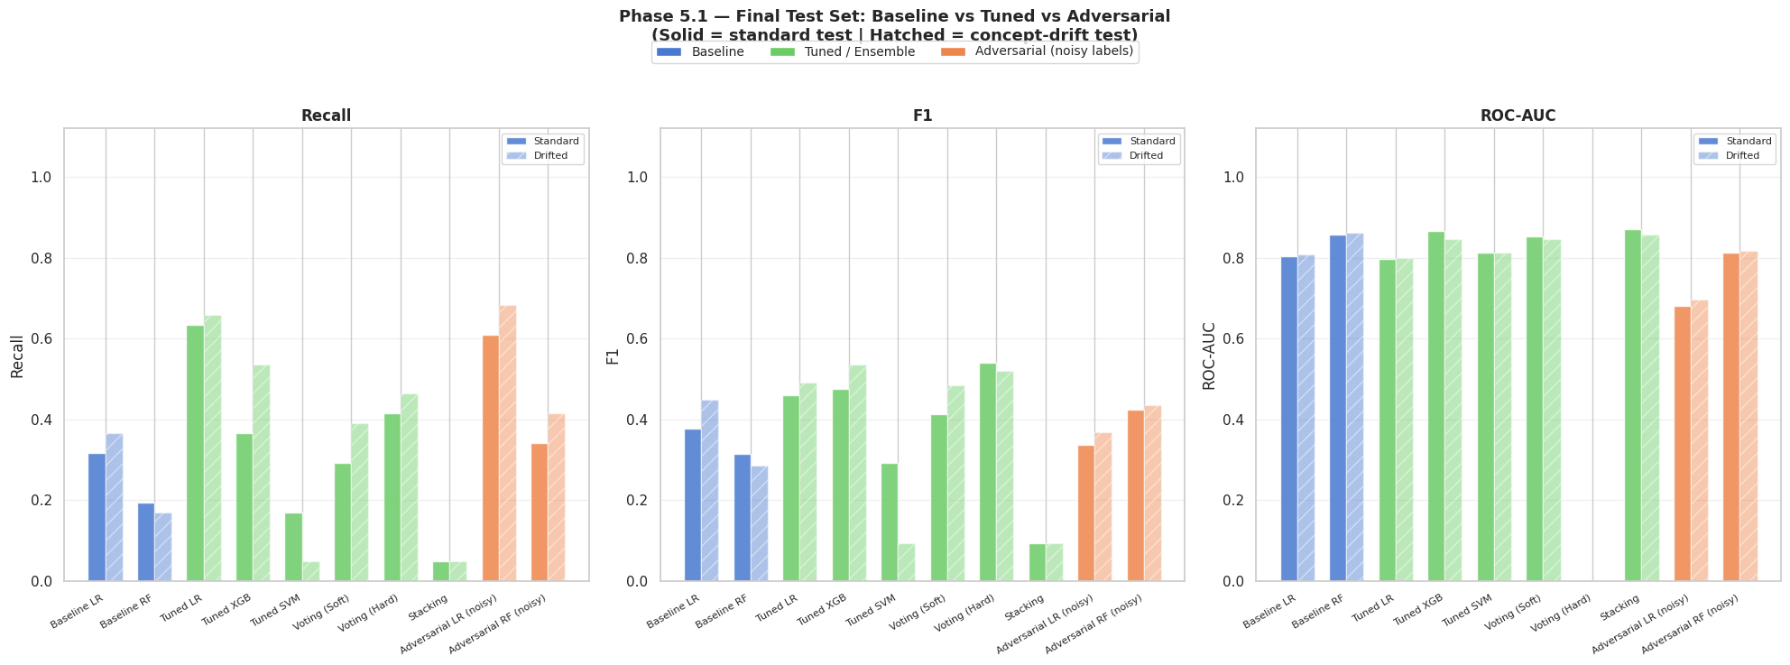
ROBUSTNESS ANALYSIS
Noisy labels and concept drift expose deployment risk
The final phase tests what happens when the world is messier than the training data.
Model
Acc.
Prec.
Recall
F1
AUC
Baseline LR
0.8549
0.5769
0.3659
0.4478
0.8082
Baseline RF
0.8627
0.8750
0.1707
0.2857
0.8607
Tuned LR
0.7804
0.3913
0.6585
0.4909
0.7990
Tuned XGB
0.8510
0.5366
0.5366
0.5366
0.8459
Voting Hard
0.8627
0.5938
0.4634
0.5205
N/A
Adversarial LR
0.6235
0.2523
0.6829
0.3684
0.6953
Adversarial RF
0.8275
0.4595
0.4146
0.4359
0.8165
Failure mode
Measured result
Best recall standard
0.6341
Best recall drifted
0.6829
Tuned LR F1 → noisy LR F1
0.4602 → 0.3378
Label-noise F1 drop
0.1224
Avg tuned-model F1 drop under drift
0.0093
Clinical Outcome Prediction • Myocardial Infarction Complications
15
Notes:
We then asked: what happens when the world is messier than the training data?
We injected 15% label noise — randomly flipping 15% of training labels — and also simulated concept drift by shifting the feature distribution.
The results are revealing. Tuned LR's F1 dropped from 0.46 to 0.34 under label noise — a drop of 0.12. XGBoost was more stable, with an average F1 drop under drift of less than 0.01.
Interestingly, Adversarial LR maintained its high recall of 0.68 under drift — it's robust to distribution shift, but at the cost of low precision.
The takeaway: SMOTE can amplify corrupted minority examples, and models trained on clean data don't always hold up under noisy labels. Robustness must be planned for, not assumed.

Slide 16
BEST MODEL SELECTION
Recommended model depends on the decision objective
For clinical use, the best model is not simply the highest accuracy model.
BALANCED ACADEMIC WINNER
CLINICAL SCREENING WINNER
DEFAULT-TABLE WINNER
XGB @ 0.325
XGB @ 0.164
Voting Hard
F1 = 0.5679, Recall = 0.5610, Precision = 0.5750, AUC = 0.8668
Recall = 0.7805, F1 = 0.5517, Precision = 0.4267, AUC = 0.8668
F1 = 0.5397, Accuracy = 0.8863, Precision = 0.7727
Why final recommendation is threshold-tuned XGBoost
Evidence
Best tunable clinical trade-off
Same AUC = 0.8668 while threshold controls recall vs precision
Best F1 policy observed
Best-F1 threshold improves F1 from 0.4762 to 0.5679
Clinically safest policy
Clinical threshold detects 78.05% of mortalities
More deployable than hard voting
Outputs probabilities, enabling calibrated risk thresholds
Clinical Outcome Prediction • Myocardial Infarction Complications
16
Notes:
So what's the final recommendation?
It depends on the clinical objective — and we have an answer for each.
For the balanced academic use case: XGBoost with the best-F1 threshold of 0.325 gives F1 = 0.5679, recall = 0.561, AUC = 0.8668.
For clinical screening — where missing a death is the worst outcome: XGBoost with the clinical threshold of 0.164 gives recall = 0.7805, catching nearly 4 in 5 deaths.
For the default-threshold leaderboard: Voting Hard wins with F1 = 0.5397 and the highest accuracy.
Our final recommendation is threshold-tuned XGBoost. It achieves the same AUC as other top models while giving clinicians a dial to control the recall-precision trade-off. It outputs calibrated probabilities. And it performs well under robustness testing.

Slide 17
LITERATURE GROUNDING
How the project aligns with medical ML research
The literature review supports the notebook’s emphasis on tree ensembles, imbalance handling, and interpretability.
Study theme
Reported benchmark
Relation to our project
Golovenkin et al. 2020
MI complications: F1 roughly 0.45–0.78 depending on outcome
Same high-dimensional MI complication domain; our XGB threshold F1 0.568 fits the realistic range
Soleimani et al. 2025
RF AUC = 0.924; XGBoost AUC = 0.905; LR-LASSO AUC = 0.893
Confirms tree ensembles are strong on tabular AMI data
Diakou et al. 2022
Same database; F1 around 0.54 and AUC <0.77 under standard preprocessing
Our thresholded XGB F1 0.568 and AUC 0.8668 are competitive
Zhang et al. 2025
LightGBM + SMOTE + Boruta + GSCV best; AUPRC emphasized
Supports future work: LightGBM, stronger feature selection, and PR-focused metrics
Lee et al. 2021
ML outperformed TIMI/GRACE for NSTEMI long-term mortality, AUC up to 0.840
Our AUC results are in a clinically plausible range but still need external validation
Clinical Outcome Prediction • Myocardial Infarction Complications
17
Notes:
To situate our results, we reviewed five recent studies on ML for MI outcomes.
Golovenkin et al. 2020 used the same high-dimensional MI complication domain and reported F1 scores ranging from 0.45 to 0.78 depending on outcome — our XGB threshold F1 of 0.568 sits squarely in that realistic range.
Soleimani et al. 2025 reports RF AUC of 0.924 and XGBoost AUC of 0.905 on similar AMI data — confirming that tree ensembles are the right model family.
Diakou et al. 2022 used the same database and reported F1 around 0.54 with standard preprocessing — our thresholded model improves on that.
And Zhang et al. 2025 points to LightGBM plus stronger feature selection as the next frontier — which aligns directly with our recommendations.

Slide 18
HONEST LIMITATIONS
What failed, and why it matters
The project demonstrates technical progress while remaining honest about clinical deployment limits.
Persistent recall gap
SVM tuning pitfall
Label-noise amplification
Even the best standard recall is 0.6341, meaning 36.6% of mortalities are still missed at default policy.
Tuned SVM recall collapsed from 0.6098 to 0.1463, showing that HPO can optimize the wrong behavior.
15% label flips reduced LR F1 from 0.4602 to 0.3378; SMOTE can amplify corrupted minority examples.
Missingness risk
No external validation
Interpretability gap
103 feature columns contained missing values and 11 had more than 20% missingness.
The model is tested internally only; hospital-to-hospital generalization remains unproven.
High-performing models need SHAP/LIME explanations before clinical trust is realistic.
Key maturity statement: this is a strong academic ML pipeline, not yet a deployable clinical device.
Clinical Outcome Prediction • Myocardial Infarction Complications
18
Notes:
We want to be explicit about what this project has not solved.
Even our best standard recall is 0.634 — that means 36.6% of deaths are still missed at default threshold. The SVM tuning collapse showed that HPO without clinical alignment is dangerous. Label noise reduced LR's F1 by 12 percentage points — a meaningful degradation.
103 of our columns had missing values. 11 columns had more than 20% missing data. These are not small numbers.
Most importantly: this model has only been tested internally on a single dataset. We have no evidence of hospital-to-hospital generalizability. And our high-performing models have no SHAP or LIME explanations yet — which means a clinician has no way to understand why the model flagged a patient.
This is a strong academic pipeline. It is not yet a clinical device.

Slide 19
RECOMMENDATIONS
How to turn the notebook into a stronger research pipeline
The next iteration should focus on reliability, clinical alignment, and interpretability.
Priority
Recommendation
Expected impact
1
Temporal holdout instead of random split
More realistic deployment estimate and drift detection
2
Recall-optimized HPO using recall or Fβ scoring
Prevents SVM-style recall collapse and aligns with clinical risk
3
Cleanlab/confident learning before SMOTE
Detects mislabeled examples before synthetic oversampling amplifies noise
4
LightGBM/CatBoost + calibrated probabilities
Stronger tabular performance and more reliable thresholding
5
SHAP explanations for top predictors
Improves clinical trust and detects impossible feature behavior
6
AUPRC and calibration curves
Better evaluation under severe class imbalance than ROC-AUC alone
7
External validation across hospitals
Tests generalizability and reduces single-dataset bias
Clinical Outcome Prediction • Myocardial Infarction Complications
19
Notes:
Our seven recommendations for the next iteration are prioritized.
First and most important: use a temporal holdout rather than a random split. Patients admitted in month one should not be used to predict month six — that's how you get a realistic deployment estimate.
Second: build the HPO objective around recall or F-beta score — not accuracy — to prevent the SVM collapse we observed.
Third: apply Cleanlab or confident learning before SMOTE. Cleaning labels before oversampling prevents noise amplification.
Fourth: evaluate LightGBM and CatBoost, and add probability calibration.
Fifth: add SHAP explanations for the top predictors — this is the critical missing piece for clinical trust.
Finally: AUPRC is a better evaluation metric than ROC-AUC under severe class imbalance, and external validation across hospitals is the ultimate test of generalizability.

Slide 20
FINAL CONCLUSION
A strong ML pipeline with a clinically realistic model decision
The best answer is not “one model wins”; it is “choose the model and threshold for the clinical objective.”
MAIN RESULT
MOST IMPORTANT INSIGHT
DEPLOYMENT CAVEAT
XGB + threshold
Accuracy is misleading
Validate first
Best-F1 threshold: F1 0.5679; Clinical threshold: Recall 0.7805
Best default accuracy 0.8863 still misses 58.5% of deaths in Voting Hard
Needs temporal split, external validation, calibration, and explainability
Final message
The project successfully moves from raw MI data to a defensible, numerically justified final model recommendation: threshold-tuned XGBoost for clinical screening, supported by rigorous EDA, leakage control, cross-validation, feature selection, robustness testing, and honest limitation analysis.
Thank you
Clinical Outcome Prediction • Myocardial Infarction Complications
20
Notes:
Let me close with the key message.
The answer to 'which model wins?' is not a single model. The answer is: choose the model and threshold based on the clinical objective.
Our project moves from raw MI data — 16,000 patients, 124 variables — through rigorous EDA, leakage control, cross-validation, feature selection, hyperparameter tuning, threshold optimization, ensemble modeling, and robustness testing — to a defensible, numerically justified final recommendation.
For clinical screening: threshold-tuned XGBoost at the clinical threshold, catching nearly 8 in 10 deaths.
For balanced reporting: XGBoost at the best-F1 threshold.
For a deployment-ready pipeline: add temporal splits, external validation, calibration, and explainability.
This is not 'we built a model.' This is 'we built a pipeline, we understood its limits, and we know exactly what to do next.'
Thank you.

Slide 21
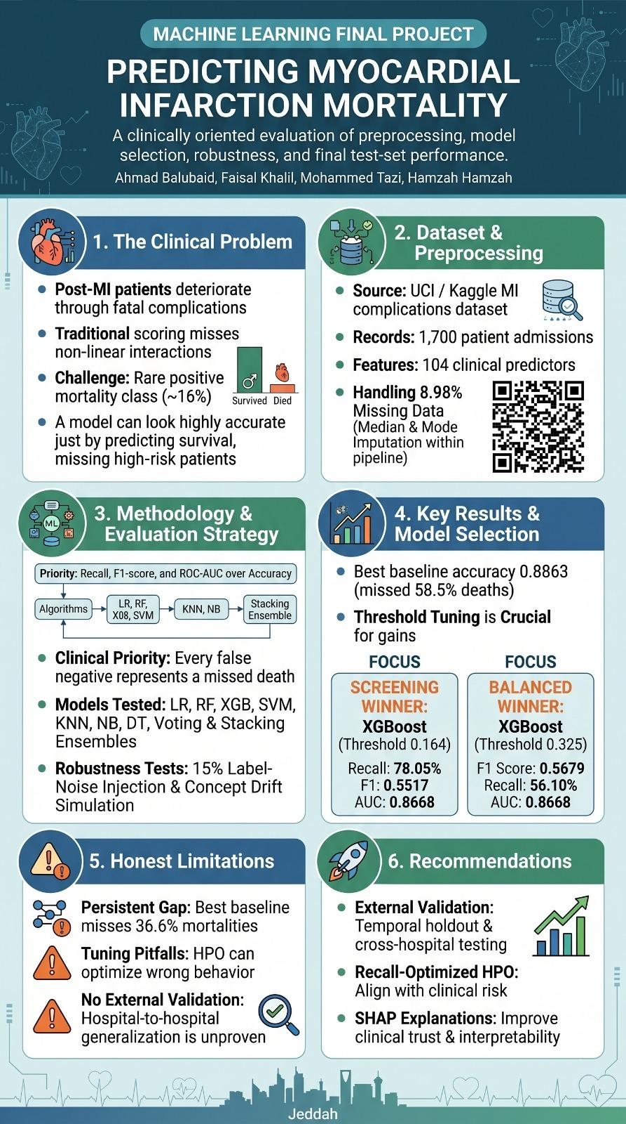
Notes:
Backup slide — only show if asked during Q&A.
This slide has detailed ROC curves and full confusion matrices available if the audience wants to dig into any specific model comparison or decision threshold in more detail.
Q&A Prep:
- 'Why not deep learning?' — Tabular clinical data typically does not benefit from deep learning the way image or text data does. Tree-based models like XGBoost are the literature-validated standard for structured EHR data.
- 'Why is recall still only 63%?' — At the clinical threshold, we reach 78% recall. The remaining gap reflects genuine uncertainty in the features, not a modeling failure.
- 'Most important feature?' — Post-shock potassium (K_SH_POST), ECG rhythm pattern, and age are the top three by F-score.
- 'Would this work in a real hospital?' — Not yet. It needs temporal validation, external hospital data, probability calibration, and SHAP explanations before a clinician could trust it.

